Slide 1

TRAVEL – ITINERARY (Around the world in eight days)
Efforts By Mentor :
Nidhi Gupta Mr. Pankaj Kapoor
Janvi Pangoriya
Mayank Goyal
Aditi Agarwal

Slide 2
INTRODUCTION
Nowadays it is impossible to understand the world of travel and lifestyle of people around the world without the social network .Today’s traveler's look for experiences through travel blogs, which have become a source of inspiration for the destination search and vacation planning.
So we are going to build one such website, with all the features mentioned above reducing the search of travelers to one place which will give them all the details of the place they want to visit.

Slide 3
OBJECTIVE
The Travel Itinerary: Around the world in 8 days is a travelling blog, a web-based application that will allow all the people willing to explore the wanderlust in them fulfill their wishes.
This application will sponsor a tour of 8 days around the world’s different countries Here we are having4 tours depending on your interest.

Slide 4
TECHNOLOGY USED
HTML - for structuring the page
CSS - for Styling
JAVASCRIPT – for interactivity
BOOTSTRAP – for responsiveness

Slide 5
HARDWARE & SOFTWARE REQUIREMENT
Hardware requirement]
Operating System : Any (Windows, Mac , Linux)
Processor : intel i5
RAM : 4GB
Software Requirement
Text Editor
Sublime
Visual Studio Code
Git
Github

Slide 6
Modules
Landing Page
Login and Sign-Up page
Tour 1
Tour 2
Tour 3
Tour 4

Slide 7
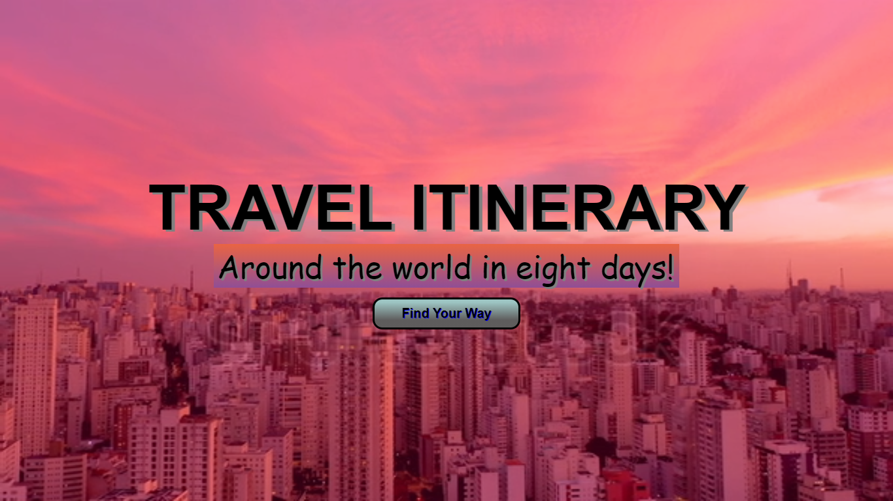
Landing Page
Splash Page of the website which appears only for 7 seconds. After that It will redirect to the login and Sign-Up page.

Slide 8
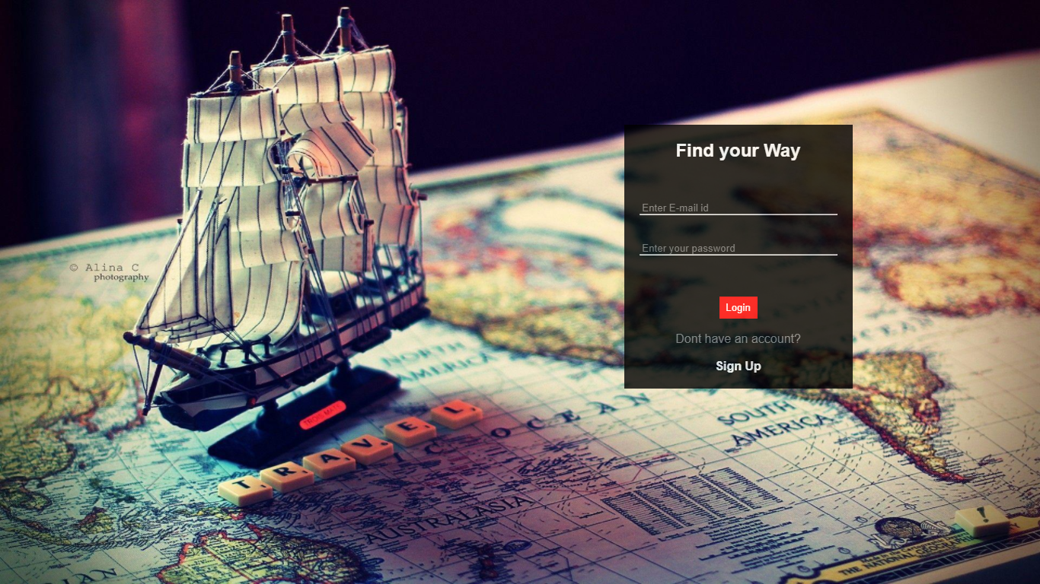
Login Page

Slide 9
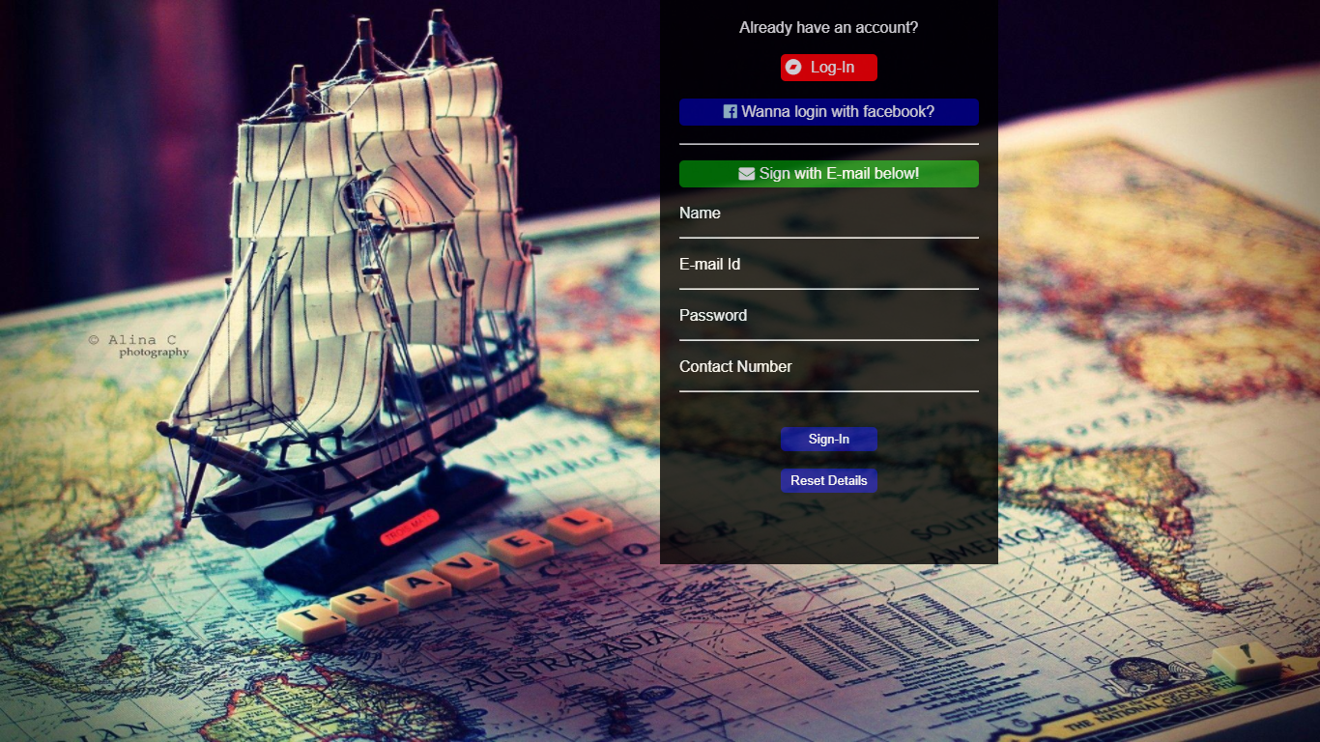
Sign-up page

Slide 10
Tour -1
The most lavish tour for holiday makers.
It consist of the following destinations:
Delhi
Isfahan
Turkey
Moscow
Seoul
Kyoto
Taipei
Hanoi
Live Link of Tour-1

Slide 11
TOUR-2
Recommended for photographers.
It consist of the following destinations:
Aukland
Cario
Dubai
London
LosAngeles
Maldives
Mumbai
Sydney
Live Link of tour-2

Slide 12
Tour -3
Recommended for backpackers and Adventure Travellers.
It consist of the following destinations:
Switzerland
Goa
Austria
Queenstown
Wadi Rum
Laojun Mountain
Interlaken
Sangil
Live Link of Tour-3

Slide 13
tour - 4
Recommended for people who want break from the life
It consist of the following destinations:
Amsterdam
Paris
Berlin
Budapest
Vienna
Venice
Milan
Live link of Tour 4

Slide 14
services
Top Destinations
Food
Accommodation
Lifestyle
Events
Book a Tour

Slide 15
SOURCE & References
Project Live Link
Source code
References:
https://www.beta-labs.in/
https://www.javatpoint.com/
w3schools.com
Source

Slide 16
Thank You

